Slide 1
HCV Assays: Impact on HCV Studies & Update on HCV blood bank protocol

Slide 2
Overview - diagnostic tests
Serologic assays: specific antibody to hepatitis C virus (anti-HCV)
Molecular assays: HCV nucleic acid (nucleic acid tests-NAT)

Slide 3
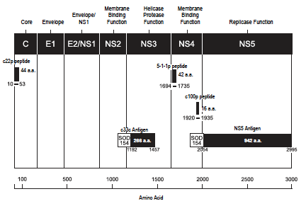
Putative HCV genome including the locations of the HCV encoded
antigens and peptides (CHIRON® RIBA® HCV 3.0 SIA)

Slide 4
Overview - serologic tests
Enzyme immunoassay (EIA)
1st generation EIA - antibodies to a single epitope NS4
2nd generation EIA – HCV core and nonstructural (NS3 and NS4) proteins.
3rd generation EIA – HCV core and nonstructural (NS3, NS4 and NS5) regions
Chemiluminescent assay (CIA)
HCV core antigen

Slide 5
Overview - serologic tests
Recombinant immunoblot assay (RIBA):
Confirmatory test
antibodies to HCV core (c22p)
Recombinant NS3 (c33c)
non-structural regions NS4 (c100p & 5-1-1p)
non-structural regions NS5
- Sensitivity 99.5%
- Specificity 98.8%

Slide 6
Overview - molecular assays
Qualitative assays
Quantitative assays

Slide 7
Initial screening test for HCV
Assay (EIA or CIA)
98% sensitivity and economical
False negative
False positive
signal-to-cut-off ratio
Notes:
Signal cut-off patient OD/cut-off-value for whole run

Slide 8
Confirmatory tests for HCV
HCV RIBA test
True positive
Intermediate
HCV RNA tests
Qualitative
Quantitative
very low limit of detection
broad dynamic quantitative range across the different HCV gentoypes
HCV testing and confirmation in low pretest probability of infection; HCV EIA → RIBA

Slide 9
EIA for Anti HCV
+
-
Negative for HCV infection
Additional Testing recommended:
Acute HCV suspected
Immunocompromised
HCV RNA
+
-
Active HCV Infection
RIBA
+
-
Resolved HCV Infection
False Reactive EIA

Slide 10
Update on HCV KATH blood bank protocol
Detection of Chronic HCV infection and recovery among a cohort of HCV positive blood donors in Kumasi

Slide 11
Aim:-
Pilot study to validate previous assay studies and develop accurate estimates of HCV prevalence and recovery.
Objectives:
Re-call and re-test previous blood donors at the KATH, to allow re-testing with third generation HCV assays as well as confirmatory RIBA and viral load testing.
Compare HCV third generation EIA and RIBA assays results to the previously used HCV rapid screening test results.
Develop criteria to define chronic infection and HCV recovery based on assay results that will be used in future studies.
Develop an initial cohort of chronically infected and spontaneously recovered subjects.

Slide 12
Methods
Participant inclusion:
Historic blood donors at KATH (2008-12) who were HCV screen test positive
HCV assays:
HCV Third generation EIA, EIA confirmatory test-RIBA, HCV RNA, and viral genotyping (if RNA is detected)

Slide 13
Summary
 | HCV Screen Positive | HCV Screen Negative | Total
Male | 35 | 27 | 62
Female | 9 | 2 | 11
Total | 44 | 29 | 73

Slide 14
THANK YOU

